Slide 1
Criminal Psychology
Session 1
P1

Slide 2
What is Criminal Psychology?
Psychology is the study of the mind, looking at mental functions and behaviour.
Criminal psychology is the study of the wills, thoughts, intentions and reactions of criminals.

Slide 3
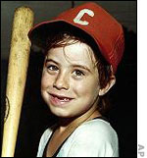
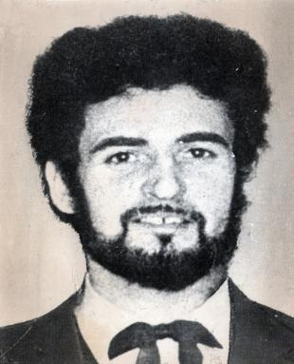
Criminal
Which of these people are most likely to be murderers?
How do you know?

Slide 4
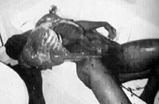
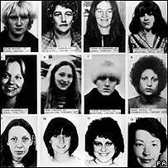
Both are Serial Killers
Jeffrey Dahmer
Peter Sutcliffe
Dahmer was convicted of 17 murders of young men, some of which he cannibalised.
The Yorkshire ripper was convicted of murdering 13 women

Slide 5
Why do some people become criminals?
There are 4 main theories
Biological
Psychological
Environmental
Sociological
Internal theories
External theories

Slide 6
Task
Freuds psychodynamic theory
Social cognitive learning (Bandura)
Operant conditioning (Skinner)
Research the above theories and explain what each one says about criminal behaviour.

Slide 7
Freud
Psychodynamic theory
A human's subconscious, the part of the personality Freud called the id, contained the aggressive instincts. The id operates on an instant gratification level, regardless of others and consequences.
Freud suggested that not only was aggression a natural, instinctive response but also that tension in the body built up and needed to be vented and that this was also a naturally occurring urge.

Slide 8
Skinner
Operant conditioning
Skinner's work demonstrated the theory that if a particular type of behaviour was rewarded, that behaviour would continue. If the reward stopped, the behaviour stopped.
Bandura then enhanced this theory and added that humans can also learn indirectly by observing. We can watch what happens to other people and see the reward/consequences they receive, we do not have to perform the behaviour and receive the reward or punishment ourselves.

Slide 9
Bandura
Social cognitive learning
Three main principles:
humans learn by observing the behaviour of others
we imitate behaviour and keep imitating if the behaviour is reinforced
both imitation and observational learning rely on operant conditioning principles even though sometimes the reinforcement has to be imagined and is not actual.
Bandura showed that a child, aged three to five years, could learn aggressive behaviour by watching someone else demonstrate that type of behaviour. The child did not have to stand and imitate the behaviour, rather they could watch what an adult did, then when faced with a similar set of circumstances, could manifest the behaviour for themselves.

Slide 10
Other theories
Cesare Lombroso, an Italian doctor of the 1870's, determined that some prisoners were genetically different to the general population - their biology made them aggressive and/or born to be criminals.
During the 1940's, it was shown that a number of criminals, who exhibited violent behaviour, had a higher incidence of epilepsy.
After twin and adoption research, it was concluded that violent behaviour was not inherited.
There is much argument about what genes actually do determine. If aggressive behaviour, as all behaviour, is determined by the brain, and the brain's development is determined by genes, then all behaviour must be genetically encoded.
mental illness, whilst not a physical disease of the brain, changes the brains functioning. If the function of the brain is interfered with, then personality and responsibility could undergo change.

Slide 11
Task
YouTube - Dexter Episode 12 Secret *ULTIMATE SPOILER*
Which theory best explain why Dexter and his brother have become serial killers?

Slide 12
Assignment 1 – P1
Describe how three psychological perspectives have been used to explain criminal behaviour.
You will need to do extra research and explain how they came to these theories, research the studies they carried out and what they found.

Slide 13
Draft deadline …………….

